Slide 1

Reception Curriculum Meeting
Monday 14th September 2026

Slide 2
Reception Team
Class Teachers
RW – Miss Whelton
RNS – Mrs C Norton / Mrs A Shepherd
RH – Mr Hoyer
Support staff
RW - Mrs Ede
RH - Miss Mihailova
RNS – Mrs Danczak-obi
Specialist Teachers
Mr Fricker – PE
Mrs Hurst – Music
Mr Gladman – Computing

Slide 3
School vision
Everyone at Red Hill Primary School is committed to providing the building blocks for every child to flourish in a safe and nurturing environment.
We offer a creative curriculum, enriched with opportunities to enable our pupils to understand the world around them and be responsible citizens. Through developing their resilience, independence and confidence, our pupils see learning as a way to realise their full potential.
Safe - Happy - Learning

Slide 4
Soft Start Morning
At Red Hill Primary School, we believe that in order to expect positive and respectful communication, we need to model and provide opportunities for it within our school day. Therefore, we encourage all children to come in for a soft start at 8.30am.
Once they come into their room, there will be learning activities on the tables or on the board to begin their day.
Teachers and support staff in the room play a crucial role. They engage with children, support children's excitement of learning for the day and tutor.

Slide 5
Attendance
Regular attendance is essential. While 90% may sound good, it means 19 days missed across a 190-day school year- almost four weeks of learning. Every day matters.
If we notice attendance beginning to dip, teachers will contact parents and carers to explore how we can help. This is not about criticism or judgement, but about working together to understand barriers and provide support.

Slide 6

Early Years Foundation Stage
The Early Years Foundation Stage (EYFS) sets national standards for the learning, development and care of your child from birth to 5 years old.
The EYFS is about what children learn, as well as how they learn. Effective practice is a mix of different approaches. Children learn through play, by adults modelling, by observing each other and through adult-guided learning.
It is based on the recognition that children learn best through play and active learning.

Slide 7
Overarching principles
A unique child
Developing positive relationships
Enabling environments with teaching and support from adults
Importance of learning and development

Slide 8
The areas of learning and development
Within the theme of learning and development, there are seven areas. All areas of learning and development are important and interconnected.
Prime areas
Communication and Language
Physical Development
Personal, Social and Emotional Development
Specific areas
Literacy
Mathematics
Understanding the World
Expressive Arts and Design

Slide 9
Topic overview
Autumn 1 | Autumn 2 | Spring 1 | Spring 2 | Summer 1 | Summer 2
Marvellous me! | Celebrations | Space | Traditional tales | Fantastic creatures | Heroes

Slide 10
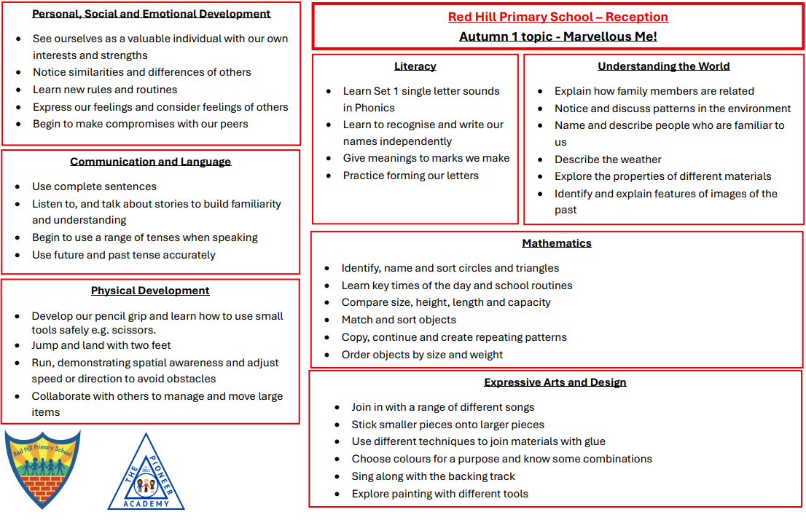

Slide 11
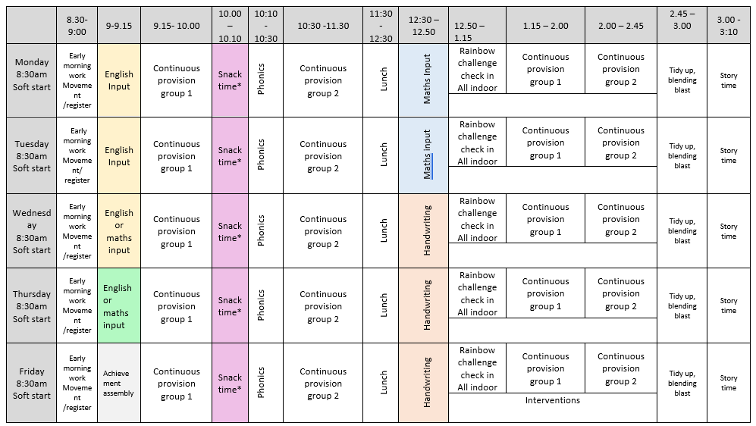
Timetable

Slide 12

Phonics – Little Wandle
Little Wandle Letters and Sounds Revised is taught in Reception through daily, structured phonics lessons.
In Reception, children follow the progression within the programme. Children learn a new sound Monday – Thursday, and there is a review session on a Friday.
Reception lessons start at 10 minutes, with daily additional oral blending. These sessions increase in time as the children continue throughout the year.
More information regarding reading books will be sent out in the coming weeks.
From this week, your child will take home a book from the book corner to share with you at home. Please ensure these are returned each week.

Slide 13
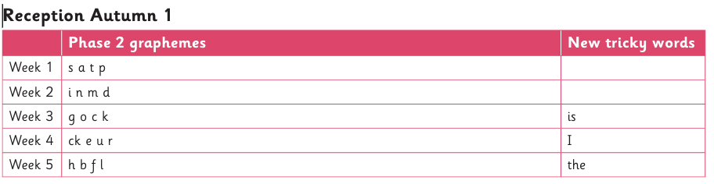
Autumn 1 Phonics overview

Slide 14
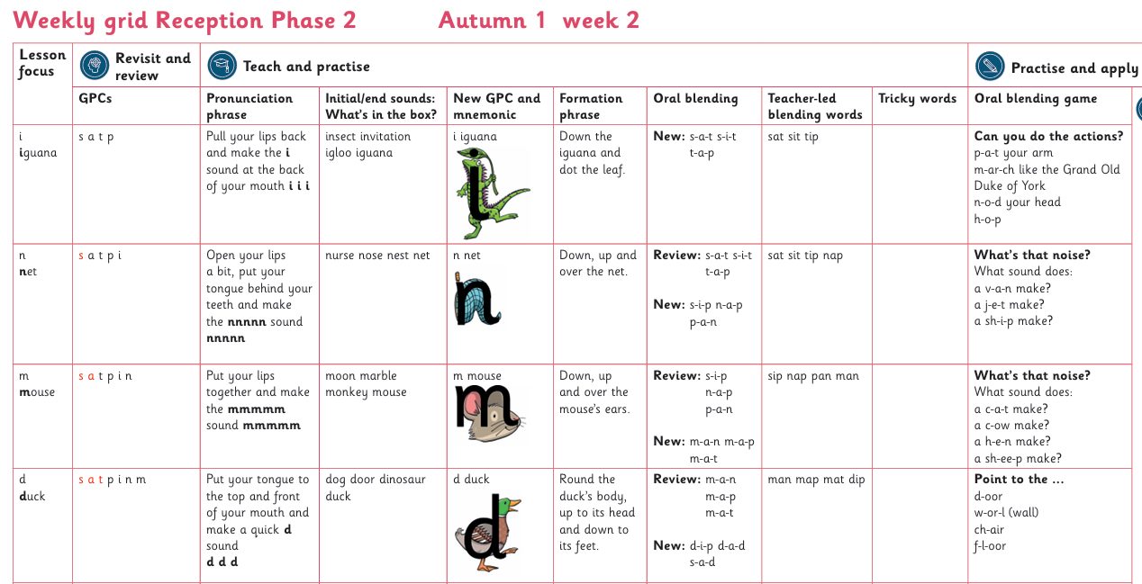
Example lesson overview

Slide 15
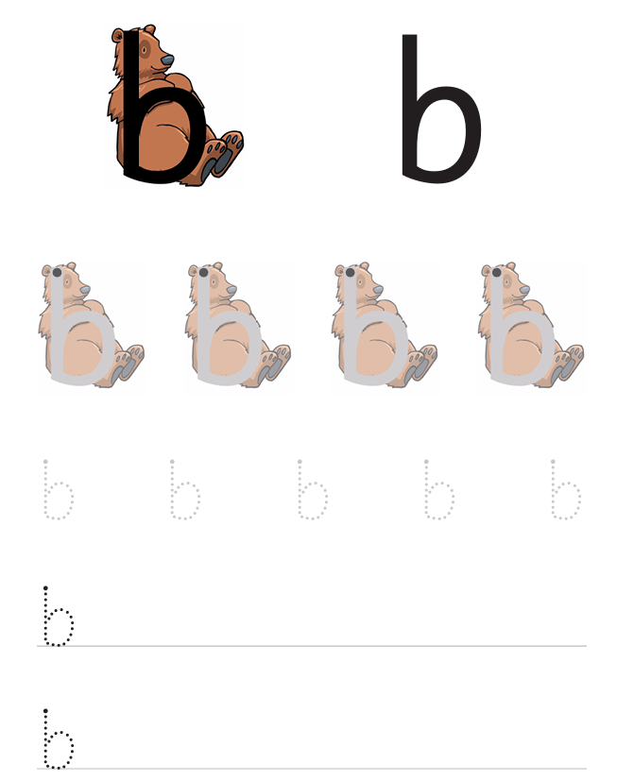
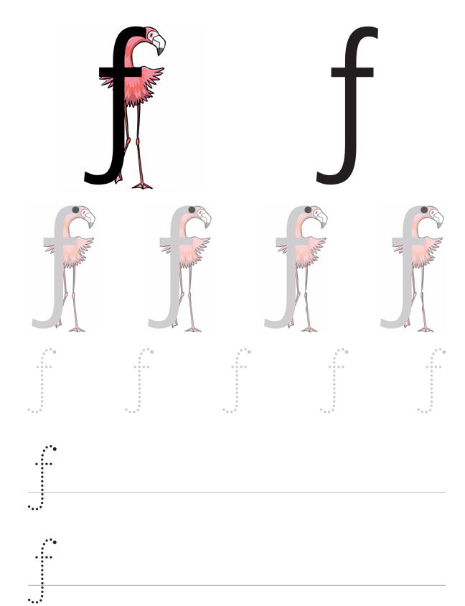
Homework
After the first couple of weeks the children will bring home a homework book. These will contain sound sheets, based on the sounds the children have learnt in phonics. We ask that they please complete the sheets each week.
Homework books will be sent out each Friday, and we ask that they are please returned the following Wednesday.

Slide 16
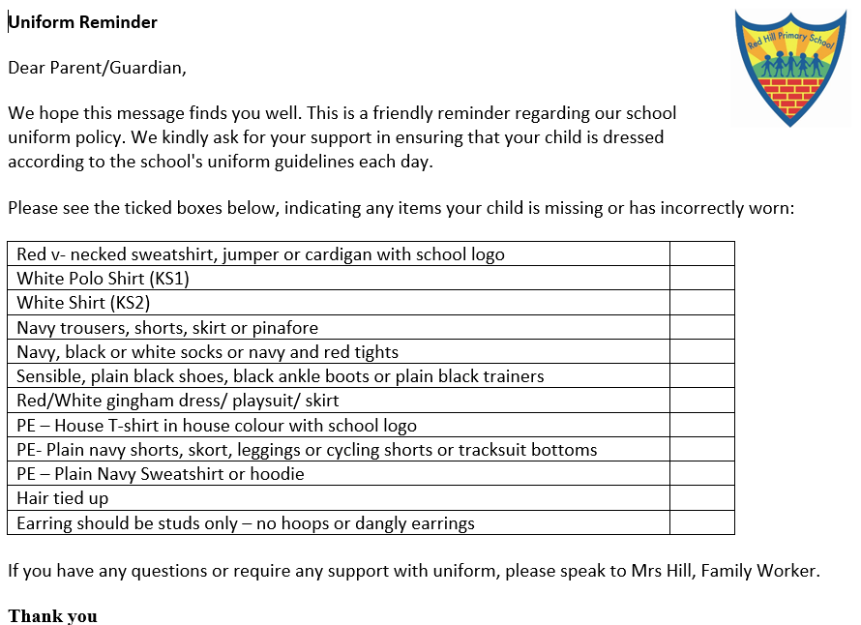
Uniform
Uniform reminders will be sent home if uniform is not correct.
If you require any support with uniform, please speak to Mrs Hill, who will be happy to help.
PE for all three classes is on a Wednesday. The children can wear their Red Hill PE kit to school and do not need to bring their uniform to change into.

Slide 17


Outdoor learning
Reception will be having their outdoor learning sessions every Friday afternoon.
These will start Friday, 25th September.
There is no expectation to have an all in one and wellington boots for the first few weeks.
For the next few weeks, please send your child in to school on a Friday in clothes (that you don’t mind getting a bit muddy!) – these must include a long-sleeved top, long bottoms e.g., leggings / tracksuit bottoms and appropriate footwear e.g., old trainers.
If you would like to send your child in in their PE kit, that is also fine.
The children will not need to bring their school uniform to change into. However, if you would like to pop a change of clothes in their bag, please do so – just in case!

Slide 18
Family photos
We have a role play area in each classroom which is currently set up as a home corner. It has proved a popular area over the past two weeks! The home corner includes resources that the children are familiar with.
To enhance the role play areas, we would like to include a photo of the children’s families and add these to the area.
Please could all photos be sent in by Monday 28th September.

Slide 19
ClassDojo
We use ClassDojo to send messages such as:
Changes to PE days
Important dates and reminders
General information for the whole Reception year group
Updates and notices
Teachers check ClassDojo messages when they can. This may not be until the end of the day, or the following day as our priority is teaching and caring for the children.
If you need to let us know about a change to who is collecting your child, or any other same-day/urgent information, please contact the school office directly.
Please do not rely on ClassDojo for urgent messages.

Slide 20
WOW stars!
Last week, we gave out a set of WOW stars. If your child has achieved something new at home or during an out of school activity, we ask you to write a short comment about it on the star. For example, swimming 5m or getting dressed by themselves. No achievement is too small or too big!
If you require a new set at any time, please let your class teacher know.

Slide 21
Important dates
Tuesday 10th November- NHS flu vaccinations
Thursday 19th November- Individual and sibling photos
Wednesday 9th December – EYFS Nativity performance
Thursday 4th March – World Book Day

Slide 22
Any questions?

