Slide 1


Year 2 curriculum meeting
Monday 7th September 2026
Information in this PowerPoint is subject to change

Slide 2
Year 2 Team
Class teachers
Miss Wright/Mrs Kimber
Ms Haynes
Ms Laverick/Mrs Mehmet
Specialist Teachers
Mr Fricker– PE
Mrs Hurst– Music
Mr Gladman- Computing
Support staff
Mrs Young
Mrs Llewellyn

Slide 3
School Vision
Everyone at Red Hill Primary School is committed to providing the building blocks for every child to flourish in a safe and nurturing environment.
We offer a creative curriculum, enriched with opportunities to enable our pupils to understand the world around them and be responsible citizens. Through developing their resilience, independence and confidence, our pupils see learning as a way to realise their full potential.
Safe - Happy - Learning

Slide 4
Soft Start Morning
8:30 – 8.45
At Red Hill Primary School, we model and encourage positive, respectful communication through our daily routines. Children are encouraged to arrive for a soft start at 8:30am and be in class by 8:45am, ready for spelling.

Slide 5
Attendance
At Red Hill Primary School, we model positive and respectful communication through our daily routines. Children are encouraged to arrive for a soft start at 8:30am and be in class by 8:45am, ready for spelling and their morning tasks, including Word of the Day.
Regular attendance is essential. While 90% may sound good, it means 19 days missed across a 190-day school year- almost four weeks of learning. Every day matters.
If we notice attendance beginning to dip, teachers will contact parents and carers to explore how we can help. This is not about criticism or judgement, but about working together to understand barriers and provide support.

Slide 6
Curriculum offer at Red Hill
Subject | Curriculum Scheme
English (Reading) | Little Wandle (EYFS – Y2) CUSP (Y2 summer to Y6)
English (Writing) | CUSP
Spelling | CUSP Spelling
Maths | White Rose Maths
Science, History, Geography, DT and Art | CUSP (this is new for these subjects this year).
French | Language Angels
Computing | NCCE or teach computing
PE | PE PRO
RE | Jigsaw
PSHE | Jigsaw
Music | Churanga?

Slide 7
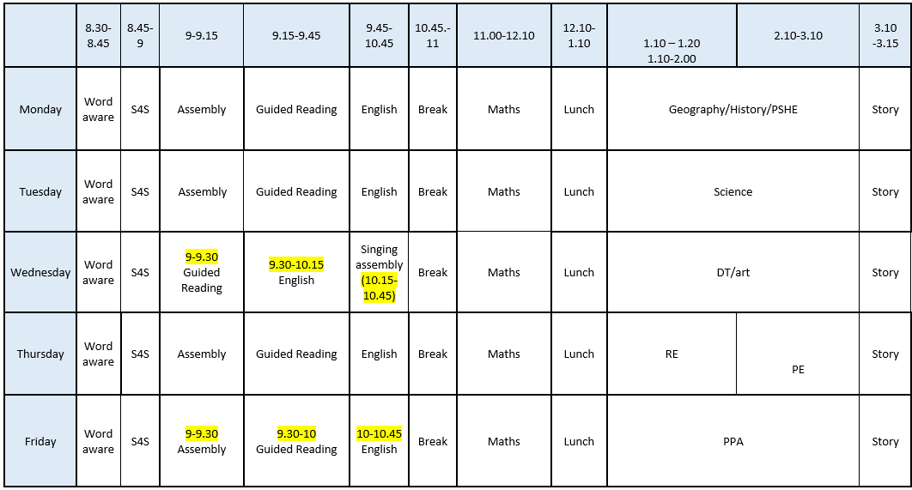
Timetable

Slide 8


English

Slide 9
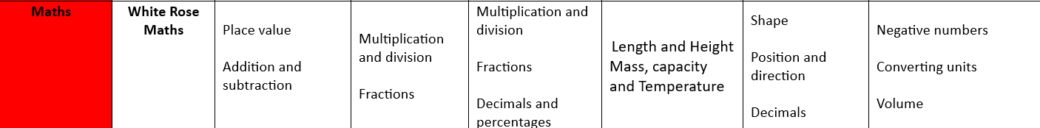
Maths
Every maths lesson starts with an arithmetic starter for first 10 minutes.

Slide 10
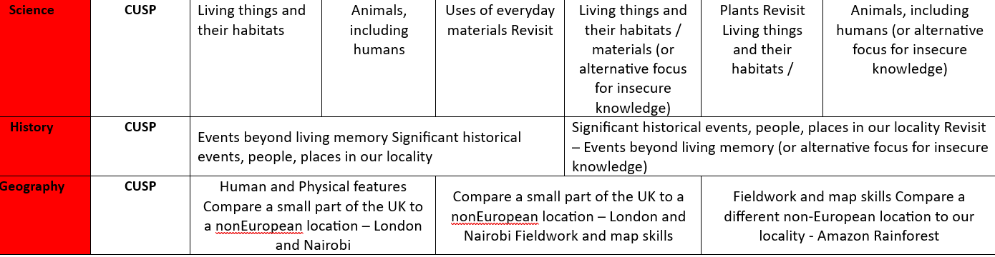
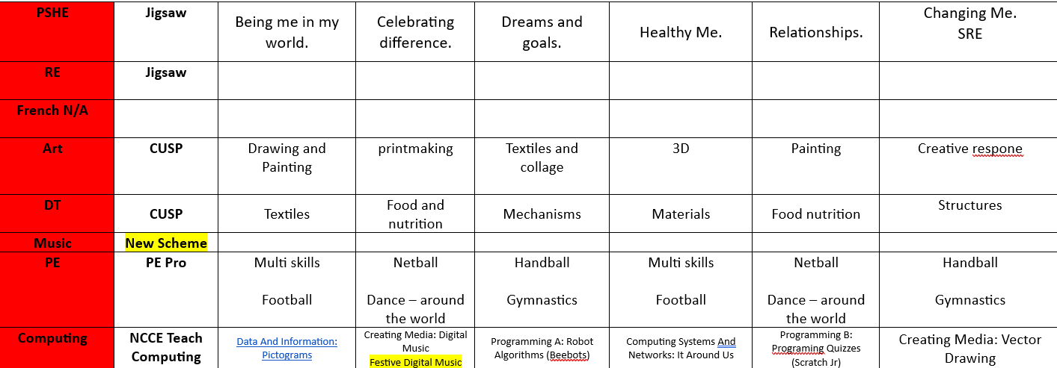
Topic

Slide 11
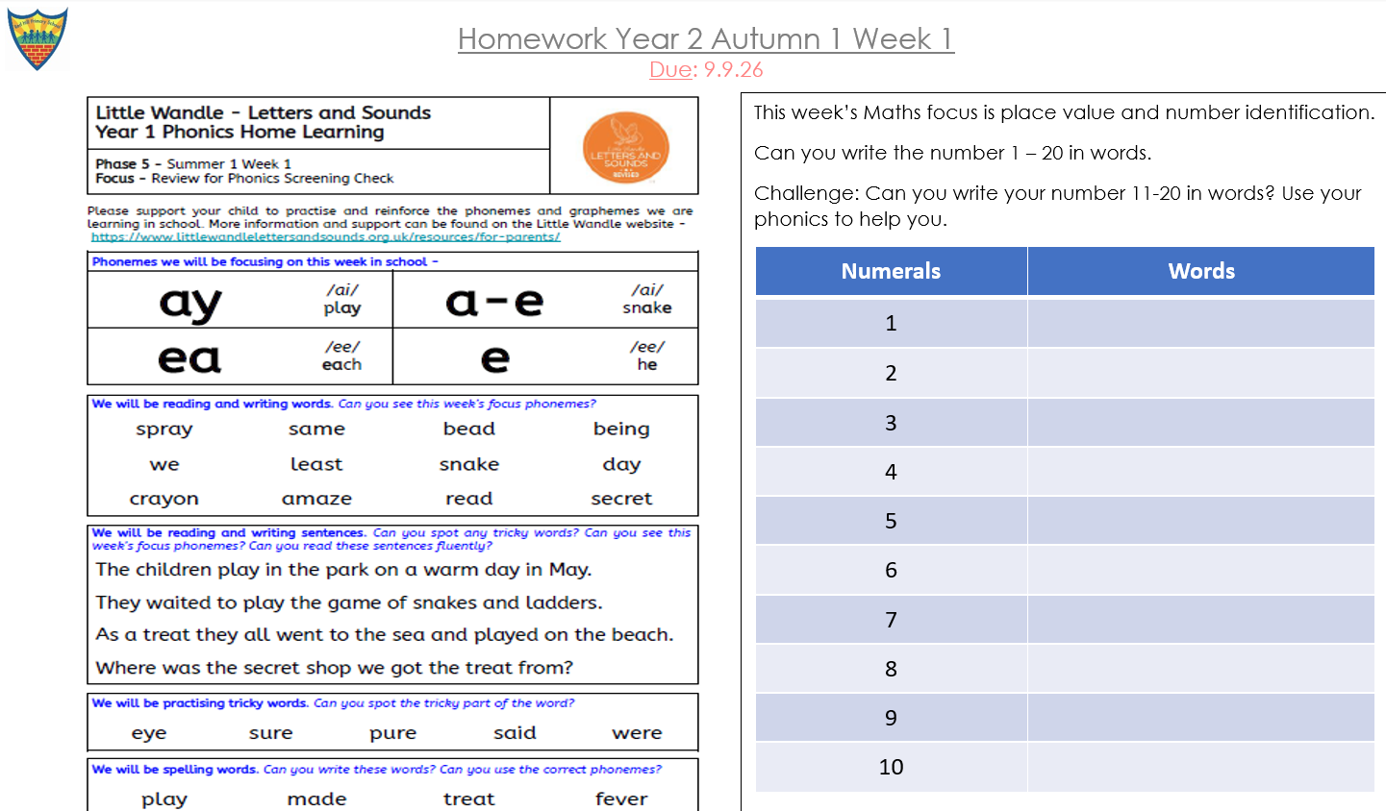
Homework
Homework is set every Friday and should be returned by Wednesday.
Reading records should be handed in weekly, with children reading at home at least three times a week.

Slide 12
Important Dates
TBC Harvest Festival to parents
10th November- NHS flu vaccinations
19th November- Individual and sibling photos
4th March- World Book Day

Slide 13
Uniform
Uniform is an important part of maintaining high standards and a strong sense of belonging. Our uniform expectations are as follows:
Main Uniform
Red V-neck sweatshirt, jumper or cardigan with school logo (iron-on badges available for £1 each from the office)
White polo shirt (KS1)
White shirt (KS2)
Tie (KS2)
Navy trousers, shorts, skirt or pinafore
Navy, black or white socks, navy or red tights
Sensible plain black shoes, black ankle boots or plain black trainers
Red/white gingham dress, playsuit or skirt (summer option)
PE Kit
House T-shirt in house colour with school logo (iron-on badges available for £1 each from the office)
Plain navy shorts, skort, leggings, cycling shorts or tracksuit bottoms
Plain navy sweatshirt or hoodie
No football kits.
Hair that is past the shoulders must be tied up.
Earrings should be studs only. Children will be asked to take any other jewellery off (unless it is for religious reasons).

Slide 14
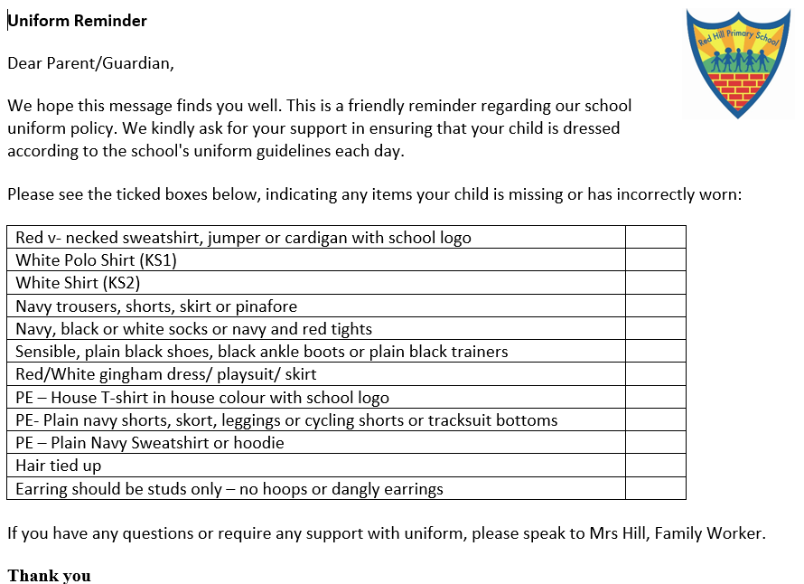
Uniform
Uniform reminders will be sent home if uniform is not correct.
If you require any support with uniform, please speak to Mrs Hill, who will be happy to help.

Slide 15
Trips
Day trips are changing this year due to the new foundation curriculum that we are using.
Trip information will be sent out when we have decided what trips align best with the new curriculum.

Slide 16
Important notes
Any changes to pick up at the end of the day need to go through the office. Staff don’t check dojo regularly during the day so may miss a message.
Staff are here to support and help but also are entitled to be spoken to with respect. If you do have concerns, please do bring it to your child’s class teacher politely and they will be more than happy to help.

Slide 17
Questions?

